Slide 1
Christmas Lecture
Review of KV4000

Slide 2

Objectives
To briefly review the programming concepts introduced over the semester
We use a simple seasonal Java application to illustrate the key ideas

Slide 3
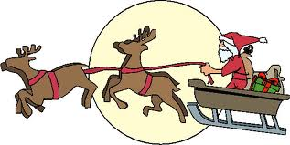
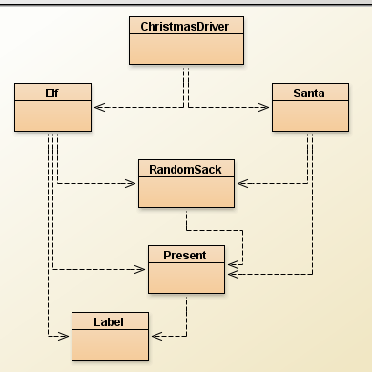






Slide 4
Overview
We want to create a present
We want to attach a label to the present
We want to put presents into a sack
We want to allow Santa to give the presents

Slide 5
The Present Class
Class: Present
attributes:
description of present
a label
indication if present is wrapped
accessors:
read name of receiver from label
read name of giver from label
read message on label
mutators:
wrap present
open present

Slide 6
Class Structure
public class Present
{
private Label label;
private String contents;
private boolean wrapped;
public Present( String contents )
{
this.contents = contents;
wrapped = false;
}
....
Attributes:
Objects
own
predefined
Primitive Type
A constructor
with a parameter

Slide 7
Methods
accessors / getters (Queries)
return values
example:
/**
* Method to read the message on the present's label
*
* @return the message on the label
*/
public String readMessage()
{
return label.getMessage();
}

Slide 8
Another method plus if
public String getDescription()
{
if ( !wrapped )
return contents;
else
return " present still wrapped";
}
Use if statement to make decisions
May have several return statements
wrapped set to false in constructor

Slide 9
More methods
mutators / setters (commands)
change state
example
public void openPresent()
{
wrapped = false;
}

Slide 10
Another method
/**
* Method to wrap present
*
* @param label the label on the present
*/
public void wrapPresent(Label label)
{
this.label = label;
wrapped = true;
}
An object parameter
Notice use of this

Slide 11
A second class
Class: Label
attributes:
name of giver
name of receiver
message on label
queries:
get giver
get reveiver
get message
commands:
none – would you want to scribble over a label !

Slide 12
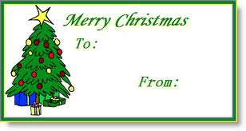
Some design thoughts
When we create a label we need to know
giver’s name
receiver’s name
the message
But what if we want to be anonymous?
Or not to designate the receiver?

Slide 13

Multiple Constructors
public Label( String message )
{
this.message = message;
giver = "unknown";
receiver = "anyone";
}
public Label ( String giver, String receiver, String message)
{
this.giver = giver;
this.receiver = receiver;
this.message = message;
}
Unique signatures

Slide 14
CollectionTypes
We looked at
ArrayLIst<ElementType>
arrays
We can use these to build “Abstract Data Types”
a collection of data
with rules about accessing

Slide 15
Abstract Data Type for Santa
Santa needs something to hold a collection of presents in
Possiblilities:
a list
a queue
a stack
a tree
We need a Sack
All standard
But
a list of presents?
a queue of presents?
a stack of presents?
a tree of presents?

Slide 16

Operation of a Sack
fill it
then take out presents
cannot fill when in ‘take out’ state
once started to take out must empty sack
Other variations
select item to take out at random
search for specific present

Slide 17
Representation of Sack
Must choose
an array?
an ArrayList?
How many presents?
is there an upper limit?
Which is easier to use?
ArrayList<Present>

Slide 18
removing the present
We are going to select presents from the sack in random order
How?
Java API?
Random (Java Platform SE 8)

Slide 19
Need
import java.util.Random;
private Random randomGenerator;
randomGenerator = new Random();
randomGenerator.nextInt(upperLimit) ;
Read API
0 – (upperLimit – 1)

Slide 20
RandomSack.java
Constructor:
public RandomSack()
{
sack = new ArrayList<Present>();
loaded = false;
randomGenerator = new Random();
}

Slide 21
Removing a present
To pick a present we use
randomGenerator.nextInt(upperLimit);
Remember each time we take a present the size of the sack is reduced.
So we must change upperLimit
the size of the ArrayList is obtained using size()
randomGenerator.nextInt(sack.size())
0 1 2 (size = 3)

Slide 22
Code
in our removeFromSack()
int index = getIndex();
return sack.remove(index);
getIndex method
private int getIndex()
{
return randomGenerator.nextInt( sack.size() );
}

Slide 23
removeFromSack()
Can only remove if sack is in loaded state
if sack is empty then no more presents
we will give back nothing
return null
code on next slide

Slide 24
public Present removeFromSack()
{
if ( loaded )
{
if ( sack.isEmpty() )
{
loaded = false;
return null;
}
else
{
int index = getIndex();
return sack.remove(index);
}
}
else
return null;
}

Slide 25
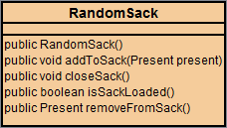

Slide 26
The User Interface
The tools we have for creating text based user interfaces are
The Scanner Class
Must be imported
System.out
Do not need anything special

Slide 27

Requirements for our UI
Two parts
Loading the sack
Giving the presents
Will use two separate classes
Elf
To wrap and place presents in the sack
Santa
to give out the presents

Slide 28
Thoughts on Elf class
Elf needs
A Scanner attribute
To know about the sack
Will need to share the sack with Santa.
public Elf()
{
keyboard = new Scanner( System.in);
sack = new RandomSack();
}

Slide 29
Elf menu method logic
Introduction
Ask For Present
while ( more presents)
{
Write Label
Wrap Present
Place In Sack
Ask For Present
}
Say Thank You
Need to turn into methods

Slide 30
writeLabel
private Label writeLabel()
{
// mix of system.out and Scanner calls to gather data
if ( giver.equals("") )
// no giver
return new Label(message);
else
// have giver name etc.
return new Label(giver, receiver, message);
}

Slide 31

and
Need to pass the sack on
public RandomSack passSack()
{
return sack;
}

Slide 32
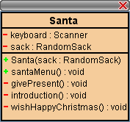
Exercise: develop Santa

Slide 33

Finally the driver
public class ChristmasDriver
{
public static void main ( String [] args)
{
Elf elf = new Elf();
elf.elfMenu();
Santa santa = new Santa( elf.passSack() );
santa.santaMenu();
}
}

Slide 34
Exercise
Develop the following three classes:
Child
Children ( a collection of Child objects)
ChildUI
The child group should permit interaction with Santa.

